Slide 1
Min Height BST
23/06/26

Slide 2
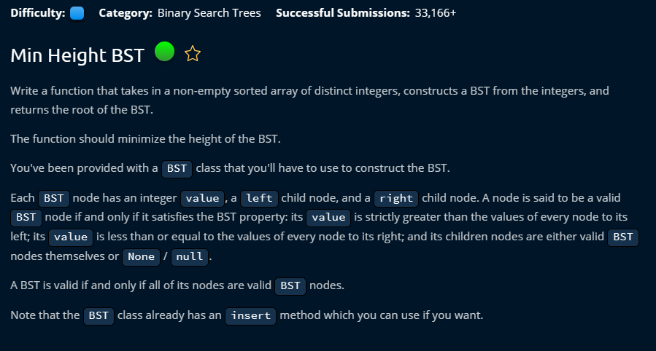

Slide 3
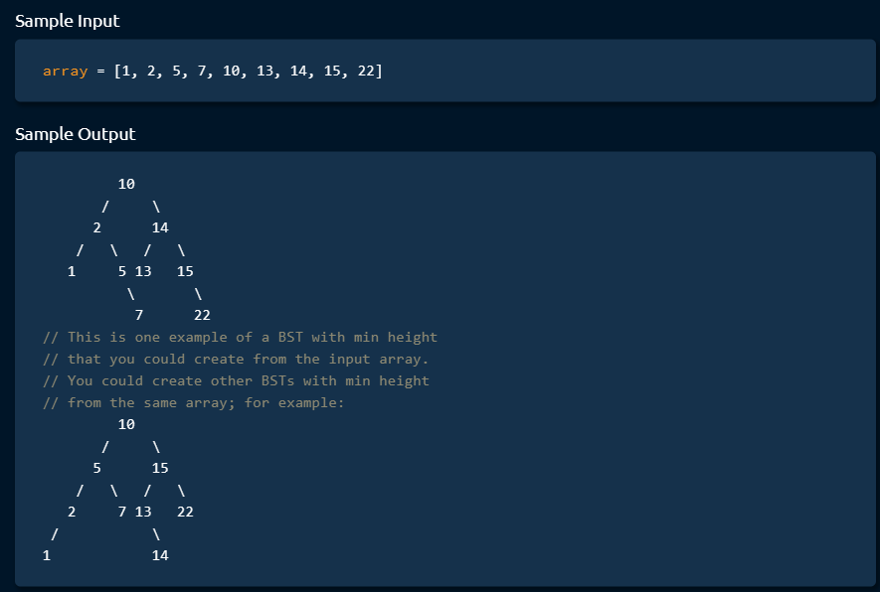

Slide 4
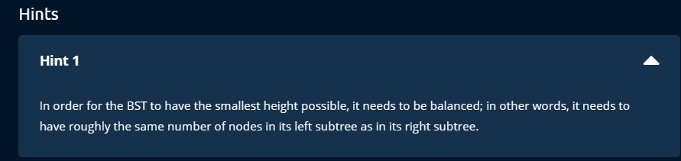

Slide 5


Slide 6
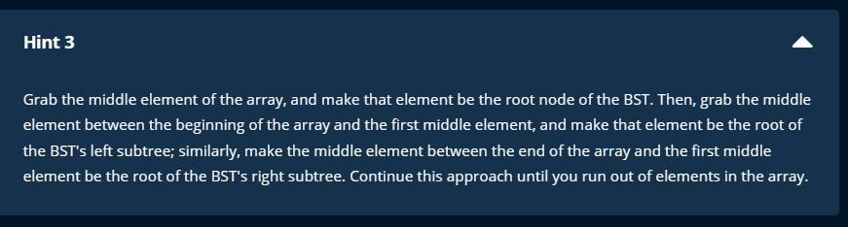

Slide 7


Slide 8
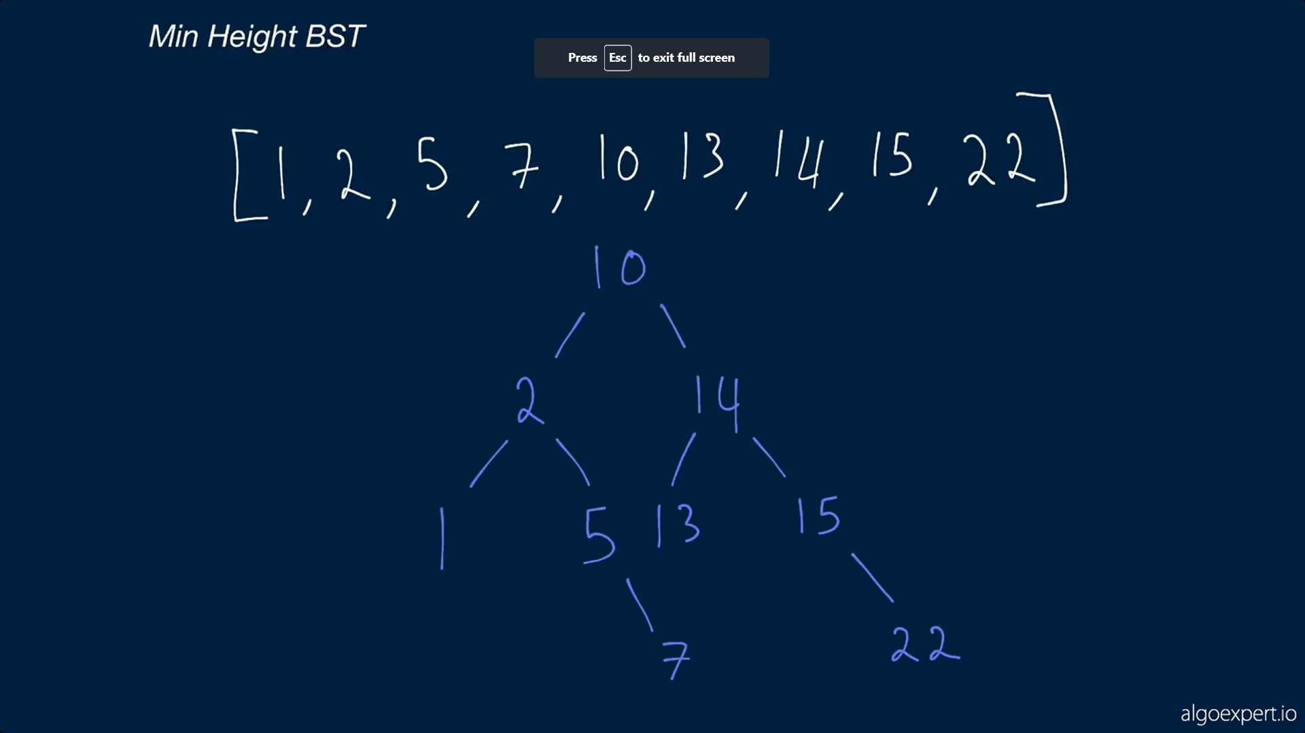

Slide 9
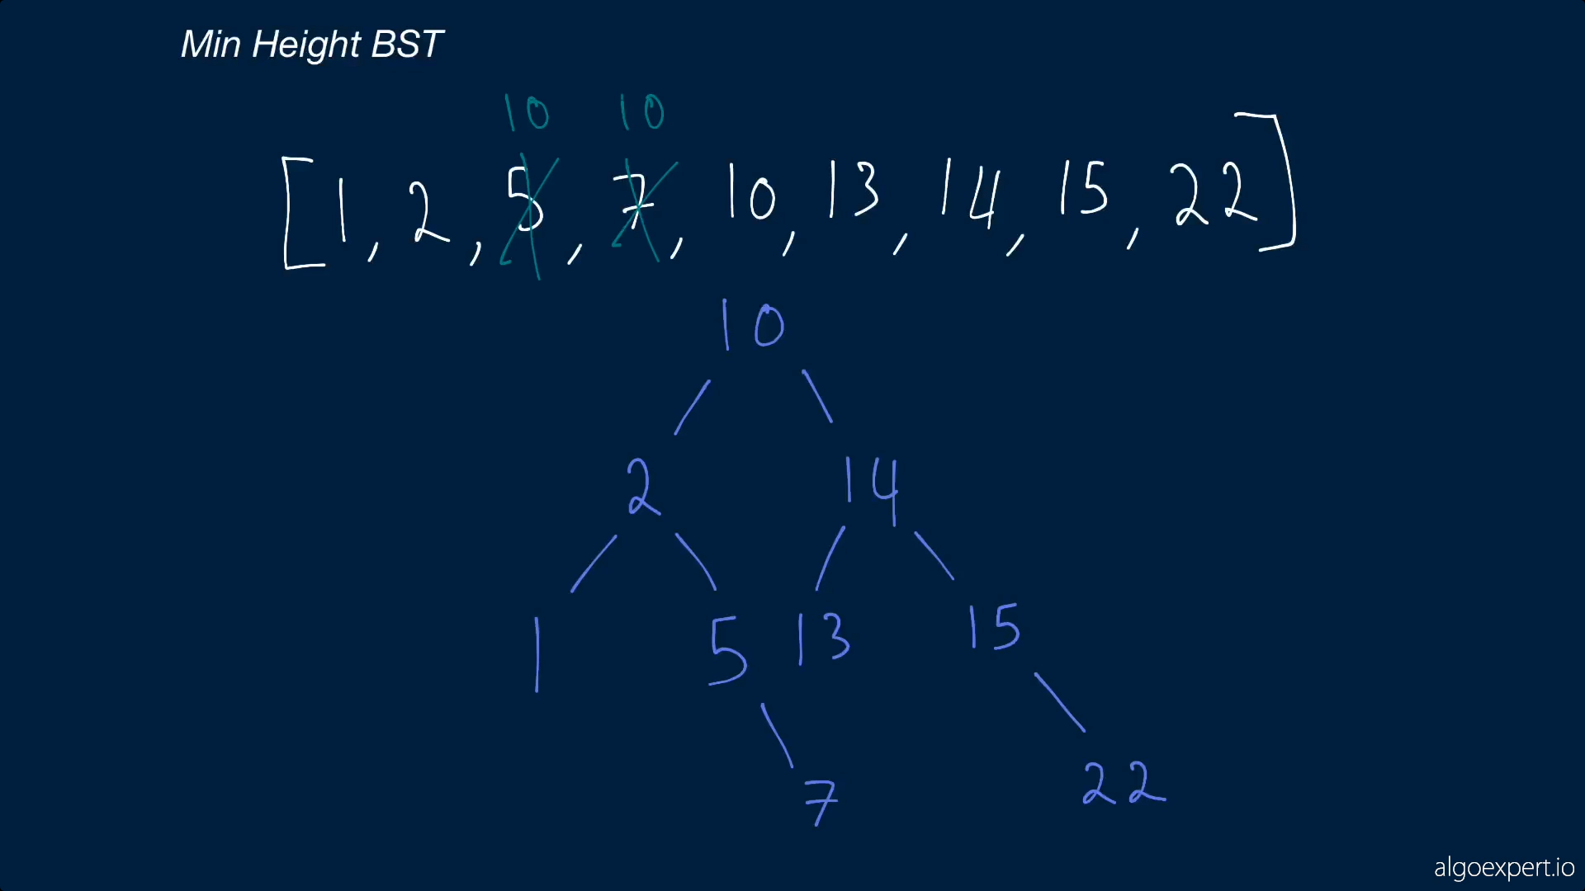

Slide 10
Notes
height = length of the longest branch of BST
PROS OF MIN HEIGHT BST : make the tree more time efficient
Balanced tree has the shortest height
in a balanced tree, the middle index is the rootnode, than follow the trend.

